Slide 1

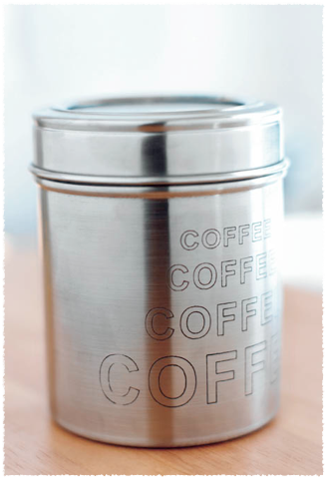
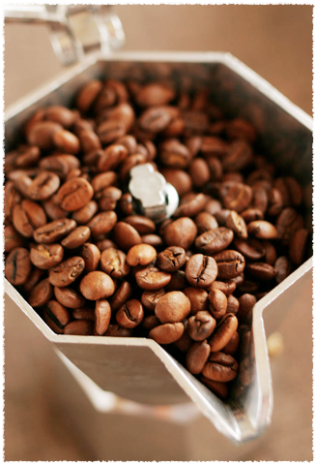

STARBUCKS
  Aqsa Nadeem 1121646
  Hedieh Ekhlasi 1132398
  Saige Xie 1211246
  Ying Deng 1205690
  Ye Xiao 1211122
  JingJing Zhang 1079310

Slide 2
Overview
History of Starbucks
Current situation and Future predictions
Strategic analysis
Issues and strategic solutions
Summary
References
Notes:
Fill this in

Slide 3

History
1971 - Opened its first location in Seattle Pike Place Market
1985 - Schultz found II Giornale offering brewed coffee made from Starbucks coffee beans
1987 - Il Giornale acquired Starbucks assets and changed its name to Starbucks Corporation
1996 -Starbucks Coffee International opened locations in Japan, Hawaii, and Singapore
2000 - Commits to the purchase of one million pounds of Fair Trade Certified coffee.

Slide 4
History
2001 -Began to offer high-speed wireless internet access in stores plus Starbucks Card to its customers
2003 - Starbucks Card Duetto Visa was lauched
2003 - Completed the purchase of Seattle's Best Coffee and Torrefazione Italia - Total store count 6400
2006 - Launches the industry’s first paper beverage cup
2008 - Chairman Howard Schultz returns as chief executive officer

Slide 5
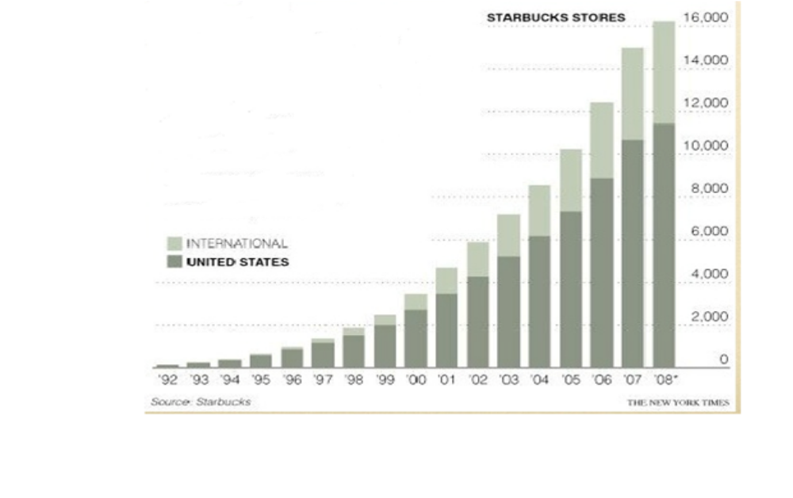
Store growth

Slide 6
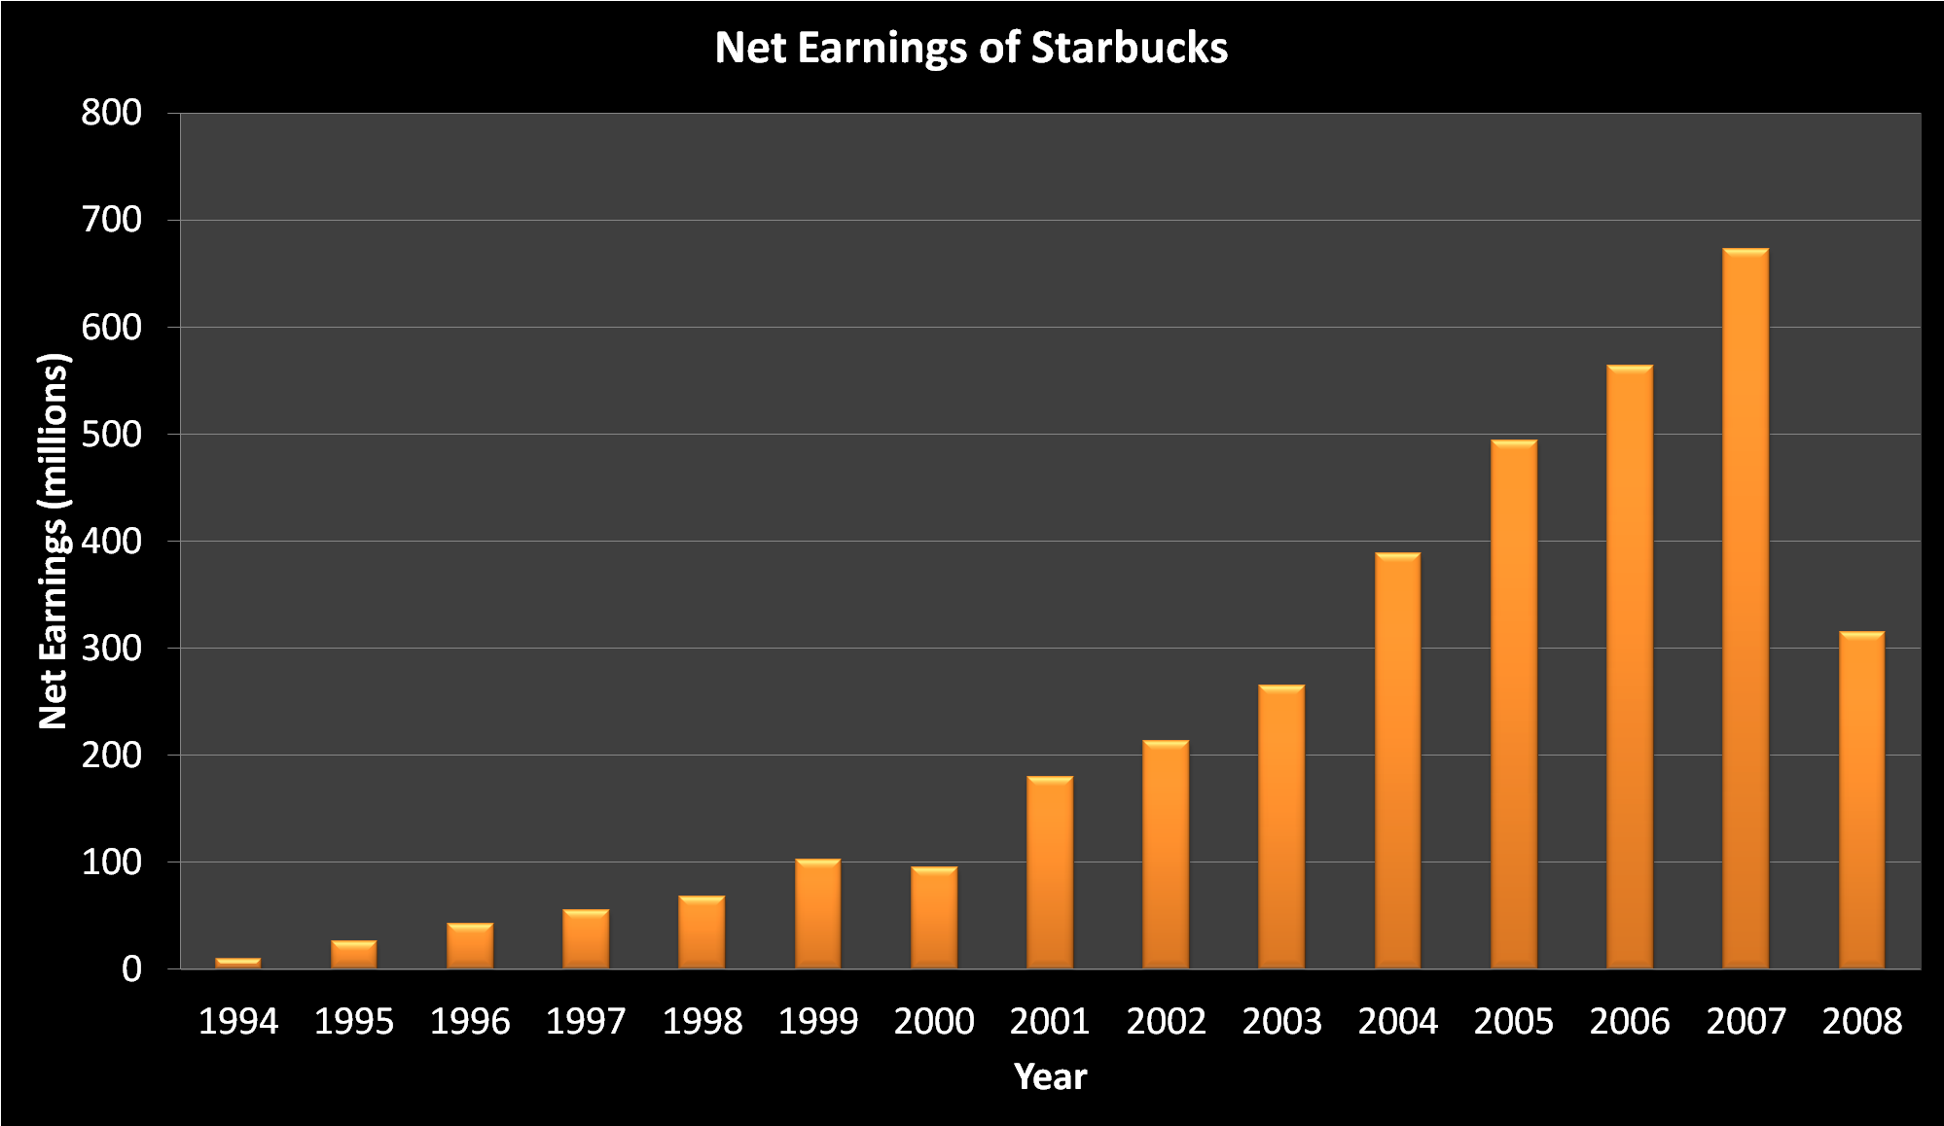
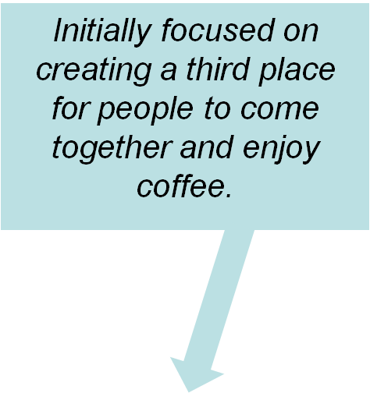

Strategies
Notes:
We need arrows and animations

Slide 7
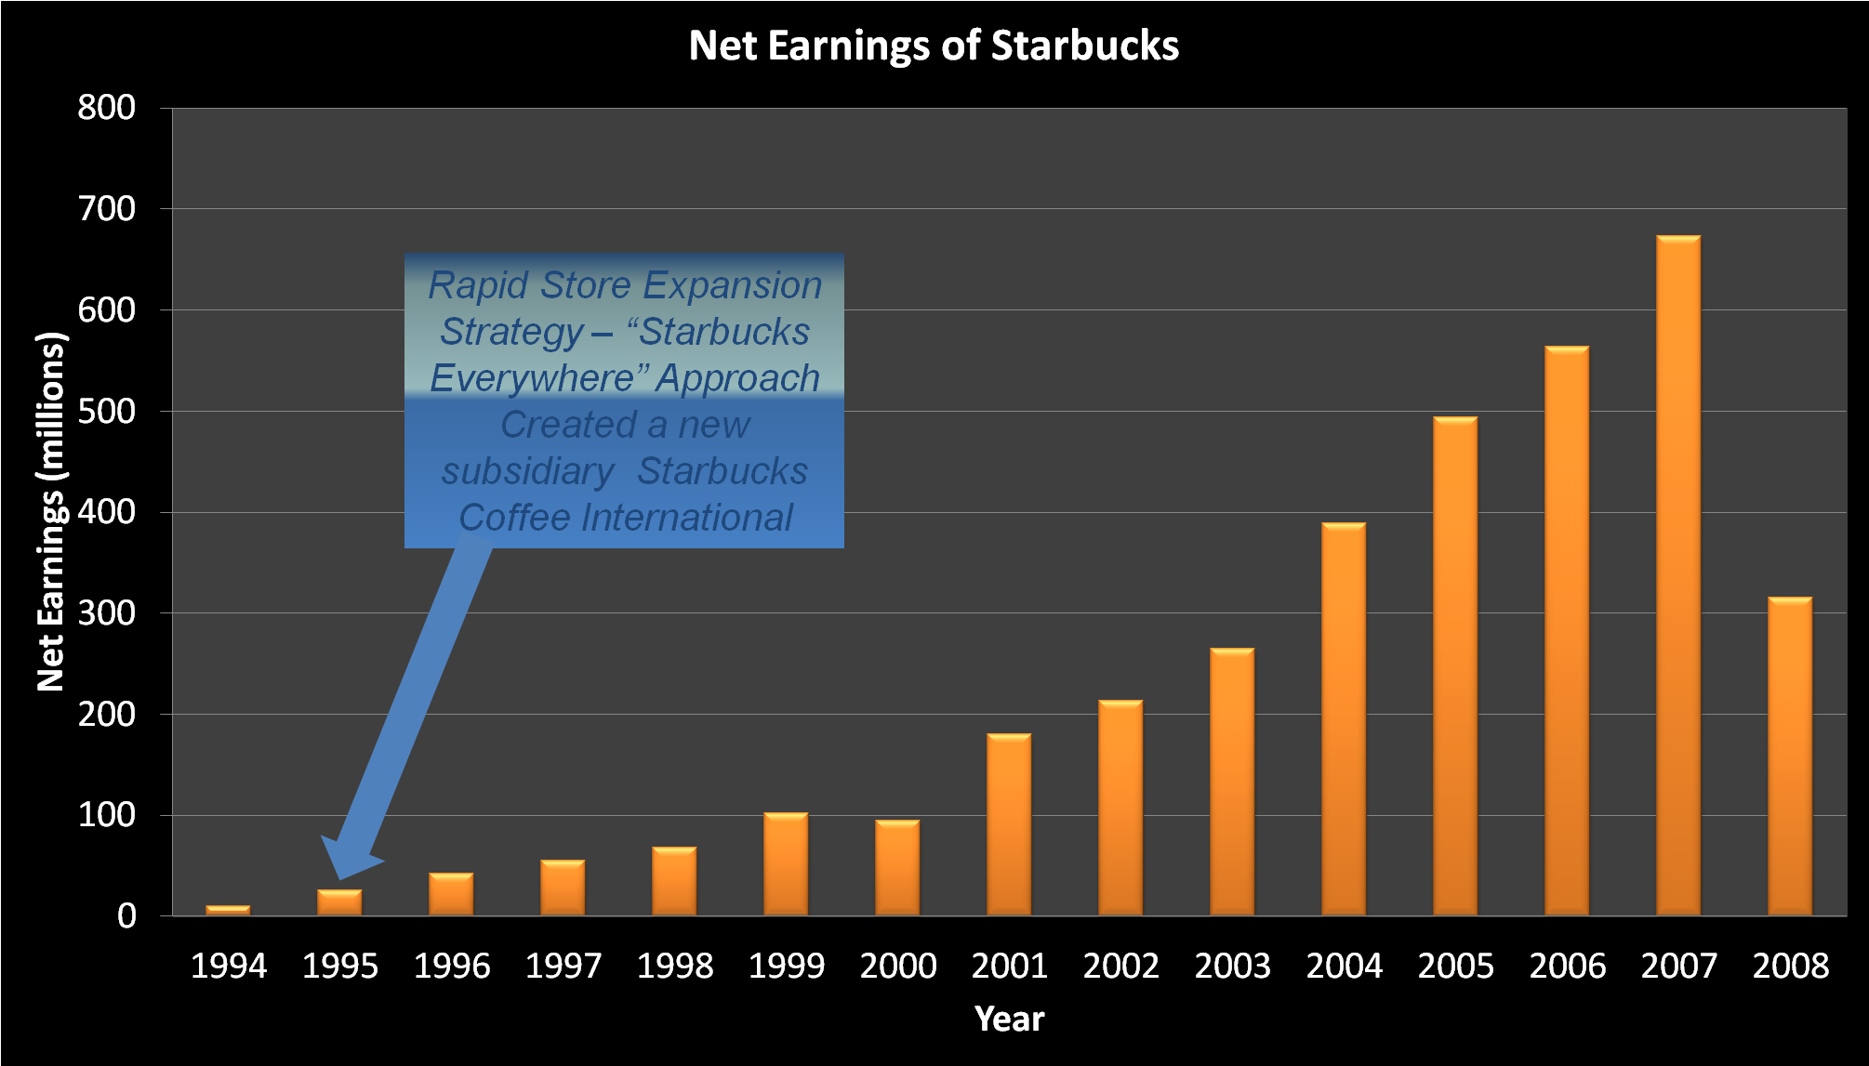
Strategies

Slide 8
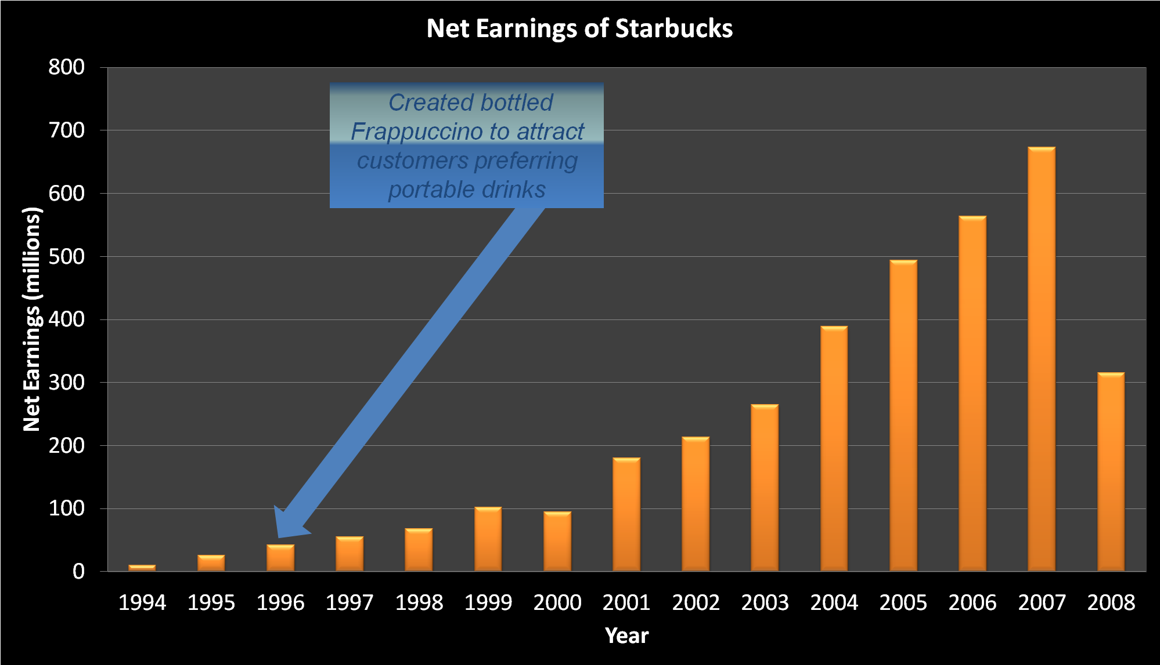
Strategies

Slide 9
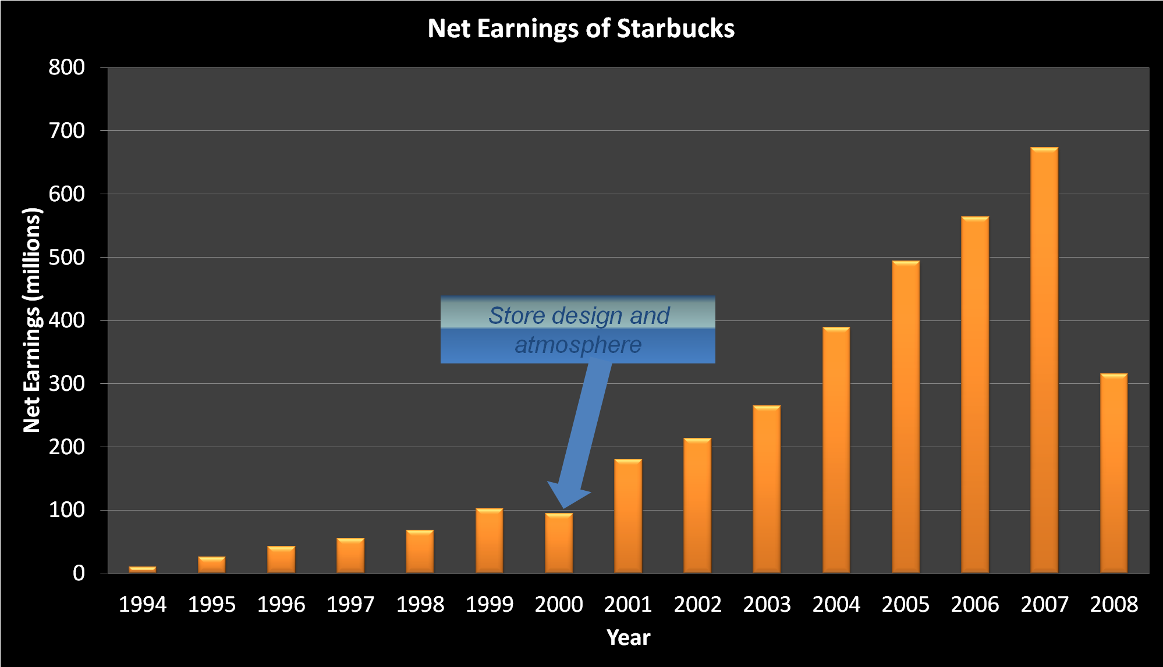
Strategies

Slide 10
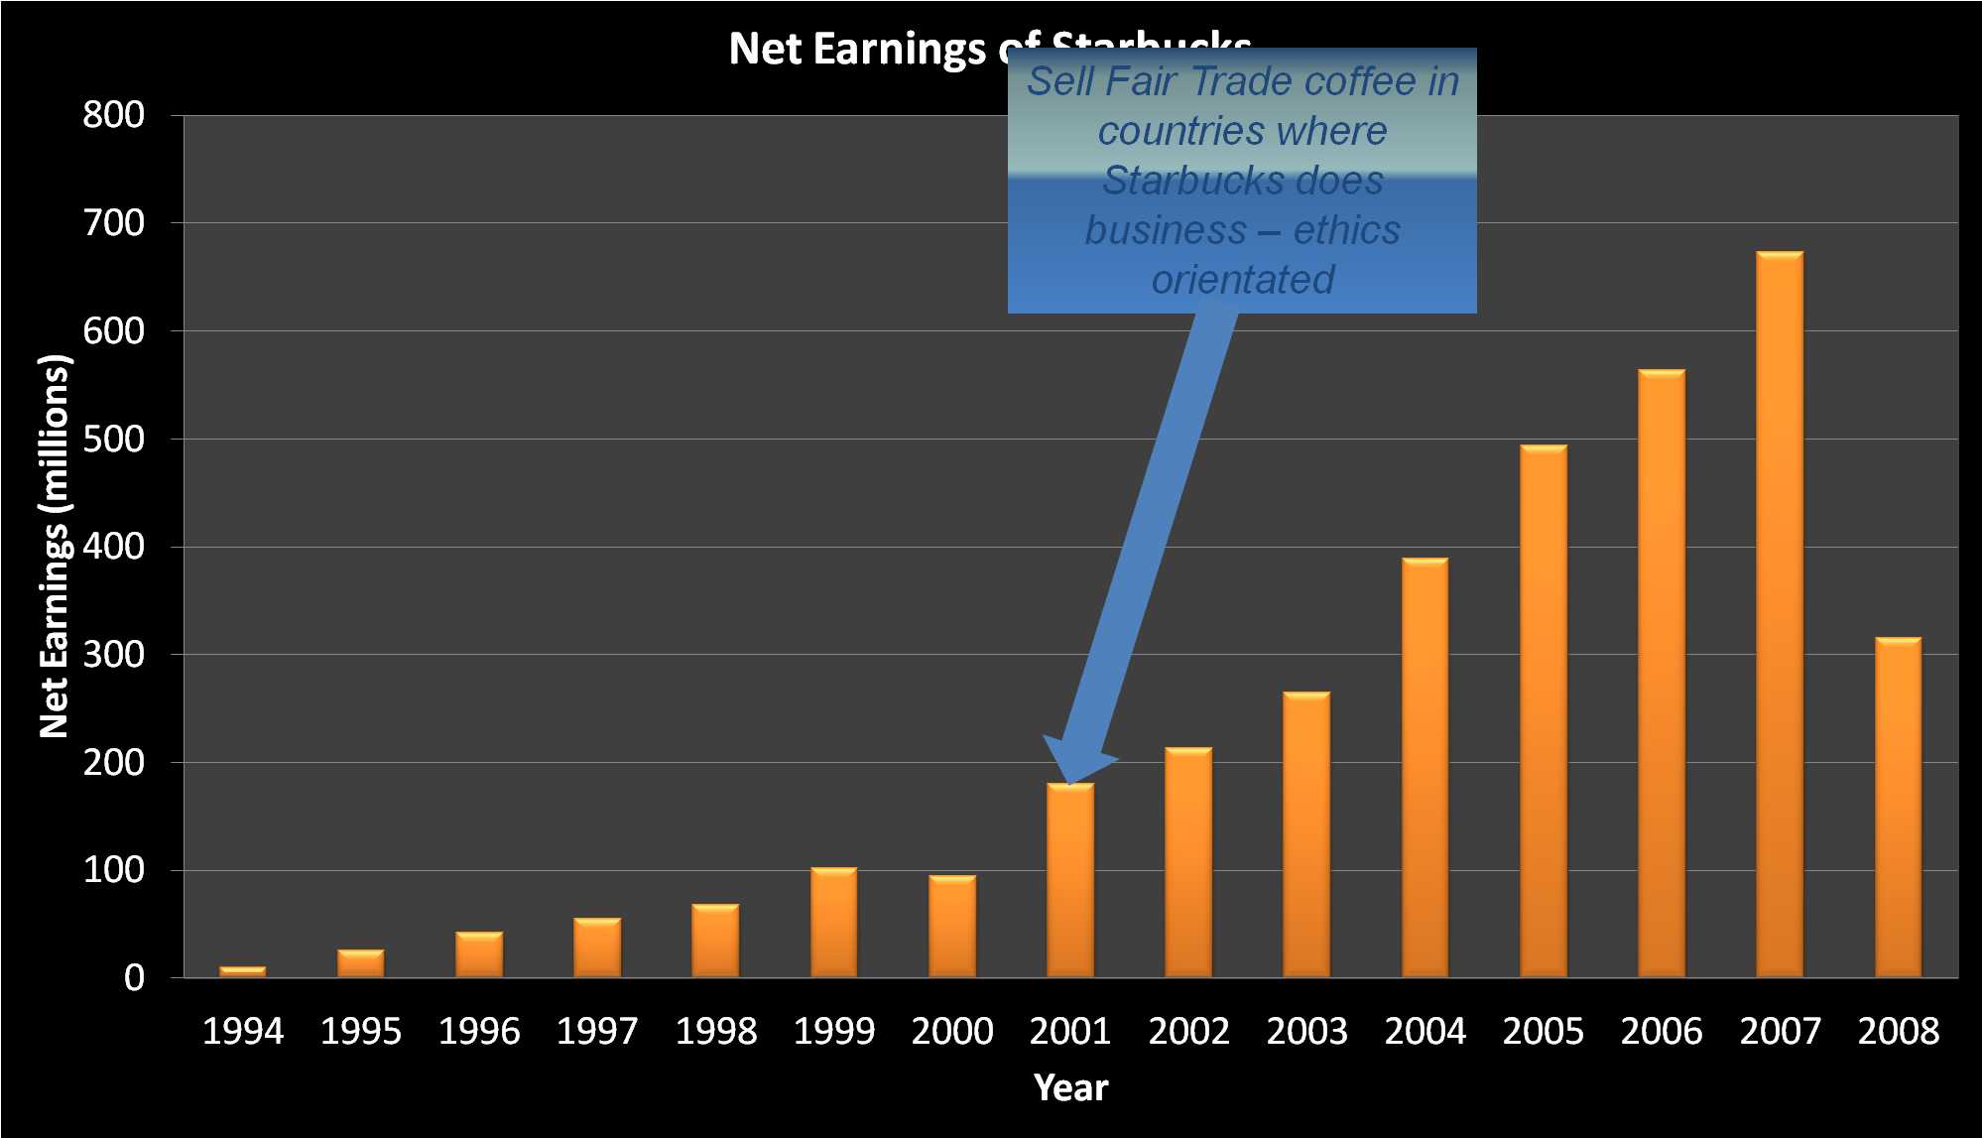
Strategies

Slide 11
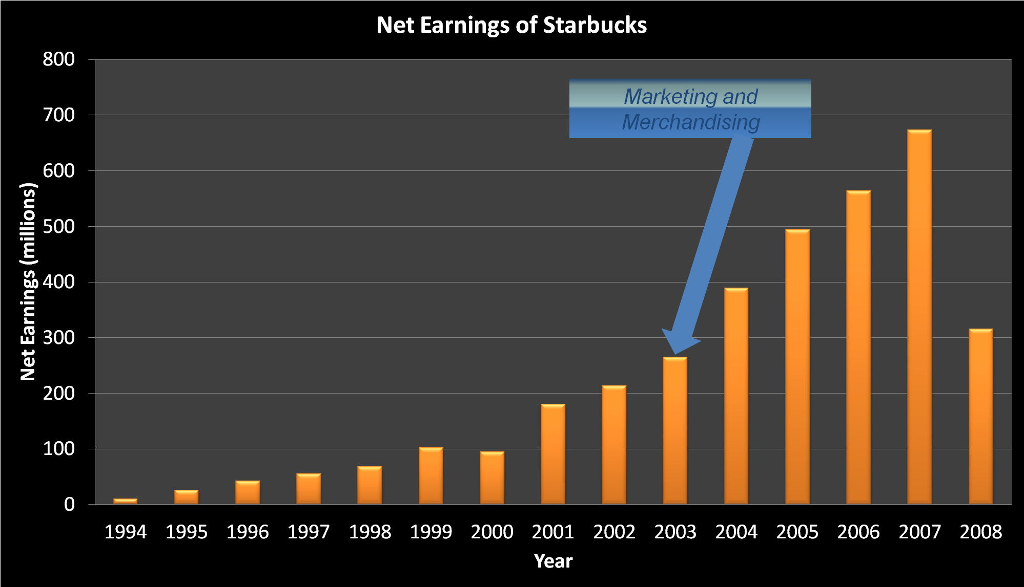
Strategies

Slide 12
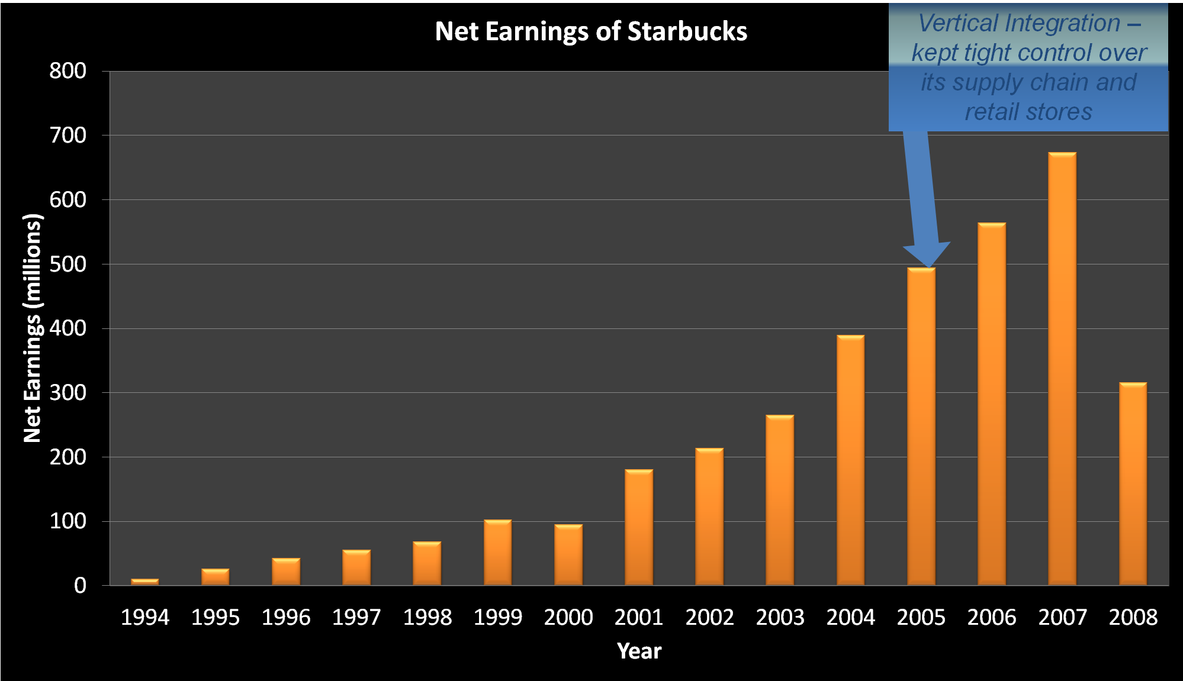
Strategies

Slide 13
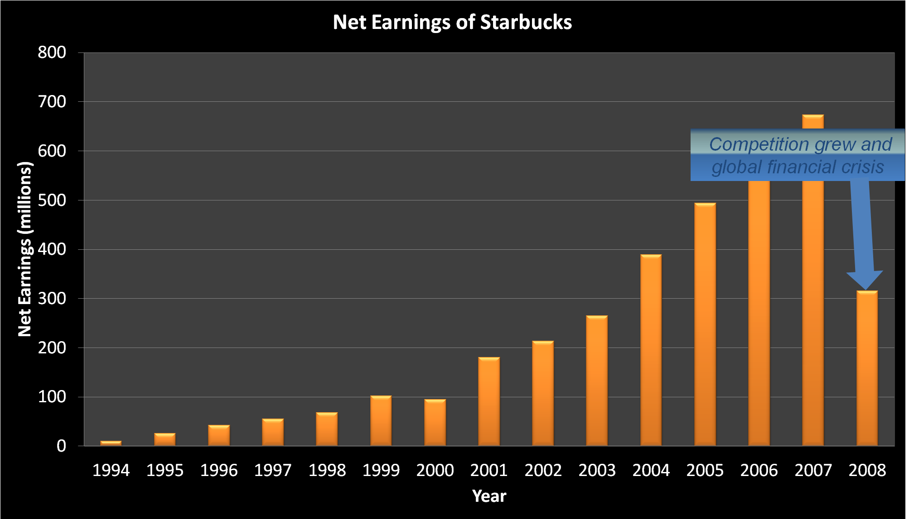
Strategies

Slide 14
Current strategies
(customers, employees, shareholders, suppliers)
Market Based View (1)
Market penetration : differentiation and product placement outside of retail stores
Third place environment: create a “third place” between work and home
Maximize profitability: focus on high margin items while generating add-on sales
Store expansion
Product line: e g. offer Starbucks coffee on United Airlines flights

Slide 15
Current strategies
Market Based View (2)
Concentric diversification : Frappuccino
Conglomerate diversification: expansion into music and movies
Market development: educating the customer about specialty coffee
Horizontal integration
Value chain development: human connection gained by business ecosystem maintenance

Slide 16
Resource Based View
Relational capital: establish close relationship with client, competitors, suppliers and employees
Cross-branding: combine two offering from separate companies to sell complementary products or services
Licensing
Supply chain distribution: effective procurement techniques

Slide 17
Organization Based View
Governance chain for a large company: contain roles of different parties which forms the management layer
Enlightened self-interest CRS: Starbucks believes that conducting business ethically and striving to gain the long-term financial benefit to the shareholders
Globalization

Slide 18
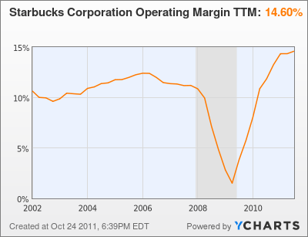
Growth trend from 2002-2008

Slide 19
Future predictions
Changes of:
Technologies (mobile applications, digital network)
Community (community service, youth actions, create jobs)
Ethical sourcing (farmer support, fair trade)
Environment (recycling ,climate change, energy, water)
Politics (stability of the countries, tax policy)
Cultures (healthy lifestyle, cross-cultural management)

Slide 20
Five forces analysis
The threat of entry :market leader + high entry barrier =>relatively immune to the threat of new entrants.
The power of buyers: no switching costs=> High buyer power
The power of suppliers: directly from producing countries: Latin America (50%), Pacific Rim (35%) and East Africa (15%) + fixed-price and price-to-be-fixed supply chain =>certain level of power against suppliers.
The threat of substitutes: cheaper coffee + ‘coffee-at-home’ maker machines + instant/homemade (caffeinated) drinks =>great substitute challenges
Competitive rivalry: catering establishments + small stores and imitators + other premium coffee providers => intense competition
Thoughts: strategies for raising customer loyalty and attracting potential customers

Slide 21
Competitor analysis
Mcdonald’s or similar catering establishments
Illy or similar premium coffee provider
Calibou or similar specialty coffee store
Nestle or similar instant coffee and coffee machine supplier
The arrows indicates the potential move of these competitors
Product range small-----------------------------------------------------------------→large
Geographical range
Local Calibou↓→
Regional Illy↓ Nestle→↓
Global McDonalds→
Thoughts: Strategies for expansion/globalization and diversification?
Starbucks↓

Slide 22
SWOT analysis
Strength
Market leader
quality and taste
High brand equity
Large scale of operations
Robust financial performance
Weakness
High product price
High operating cost
profits are highly dependent on coffee product
Weak compliance function
legal proceedings
Opportunities
Entry into Asian market
Market penetration in international countries
New mode of sales like whole bean in supermarkets
Co-branding with other food manufacturers
Threats
Increasing and more intense competition
Variation in coffee prices in developing countries
health conscious trends of customers’ thinking
Labor unions issues
Global cultural difference and community acceptance
Thoughts: Profitability (price, cost and sales), globalization, cultural and political issues, product innovation

Slide 23
KSF identification
Suitable choice of store location
Cultural fitting of different markets (taste, environment, life pace, thinking)
Reputation of brand and product introduction of new product
Quality, price and cost balancing
Rising consideration and commitment to environment issues
Employee satisfaction and development
Supplier satisfaction
Customer satisfaction and loyalty
Suitable marketing strategy

Slide 24
issues
Cannibalization of brand value
Over-crowded in urban areas
Scarcity of stores in suburban areas
Strong presence in US
Concentration of investments on the same type of products
Size of stores
Customers trends toward more healthier way
High Prices
Lack of internal focus-leadership
Poor advertising
Cultural and political issues in foreign countries
Achieve customer and supplier loyalty

Slide 25
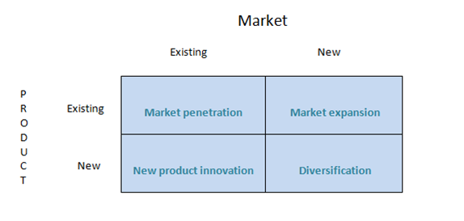
Growth strategy

Slide 26
Market Penetration
Drive-thru Market
Increase the quality and quantity of comfort utilities (sofas, Wi-Fi-, etc)
Shut down stores with lower profits

Slide 27
Market Expansion
Airlines (i.e. Licensing)
Investment in suburban – rural areas
Expand internationally
Brand their own instant and ready to drink products

Slide 28
New Product Innovations
Low calorie drinks
Coffee Machines
Energy drinks
Liqueur drinks

Slide 29
Diversification
Baking business
Ice creams
Chocolate
Invest in natural drinks market (e.g. Juices)
Invest in package manufacturing

Slide 30
High price issue
Lower the quality
Lower the operating cost
Co-branding
Brand a second, low-price product

Slide 31
Lack of internal focus
In 2011, the Wall Street Journal reported that Employees at Starbucks in Chile plan to walk out because of their low wages.
Technology push and market pull
    Use high-efficient machine to replace low-tech manual work
    Use high-technology decoration in the dining area
    Use innovative supply chain to make the coffee fresh

Slide 32
Corporate social responsibility (CSR)
Offer its employees equity compensation
Offer benefits for employees:
Benefits for employees
Full-time employees
life insurance
dental
vision
Paid vacation
Retirement plan
Part-time employees
Life insurance
dental
vision

Slide 33
Marketing Strategy
Starbucks was running a promotion where every week you buy a cup of their bold coffee and collect a stamp. After eight weeks you can trade the stamps for a free pound of coffee.
Television
Newspaper
In-store materials
Digital content

Slide 34
Business model innovation
Use direct sales through the Internet
Develop delivery service
Co-branding with other companies

Slide 35
Strategy evaluation
Suitability
Acceptability
feasibility
Check whether the promotion meets these three criteria.

Slide 36
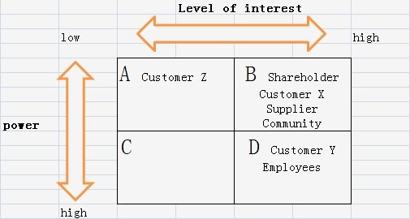
Current stakeholder mapping:
Customer X:
Largely supporting Starbucks
Customer Y:
Largely hostile to
Starbucks
Customer Z:
Don’t care about Starbucks

Slide 37
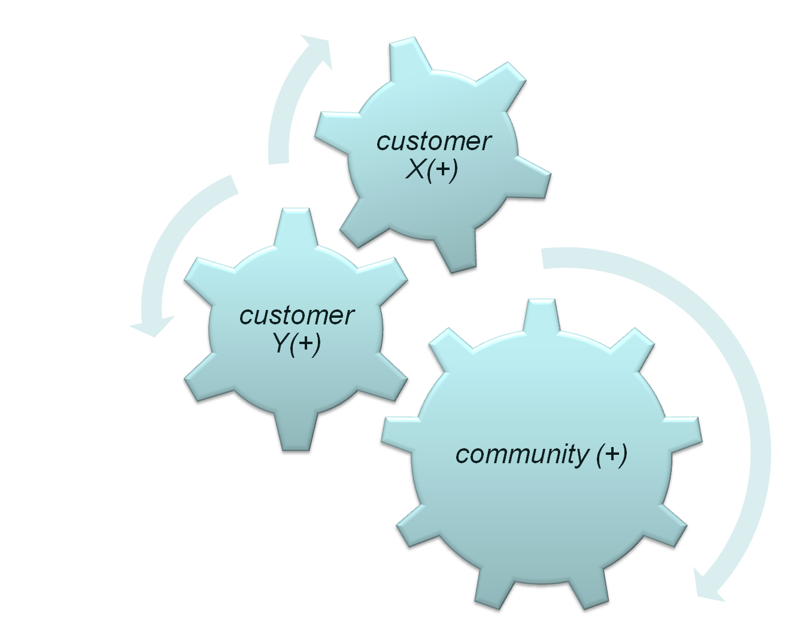
Improved stakeholder mapping(2)
Shift customer X and community
from group B to group D

Slide 38
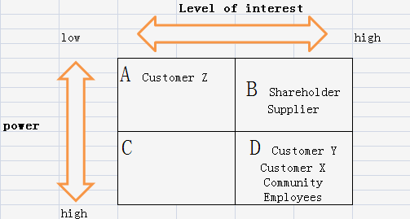
Improved stakeholder mapping (1)

Slide 39
Recommendations
customer loyalty
Increase the connection between customer, community and Starbucks
supplier loyalty
  Reward system for farmers who provide higher quality coffee beans
  Ensure good living conditions of farmers and protect local ecological environment
Cultural issue in foreign countries
  Do survey( questionnaire etc.) to know about the popularity and acceptability of Starbucks before entry
  Have a good understanding of culture and history of foreign countries
Political issue in foreign countries
seek for legal protection and admission before entry

Slide 40
Summary
Growth strategy ( expansion, diversification, innovation, penetration)
Cultural and political issues in global market
Quality and profitability
Internal focus
Customer and supplier loyalty
Marketing strategy

Slide 41
References
http://www.nytimes.com/
Antonio Perez. (2012). Starbucks Plans Aggressive Growth Strategy.
Melissa Allison. (2010). Starbucks has a new growth strategy — more revenue with lower costs
http://starbucks.co.uk/

